Slide 1
Bazele inteligenței artificiale
Laborator – Grigore Ionuț

Slide 2

today’s lab

Slide 3


Slide 4
Content
Linear regression
Gradient descent
Polynomial regression
Regularized linear models
Logistic regression
Softmax regression

Slide 5
Big picture first, details last

Slide 6



Slide 7
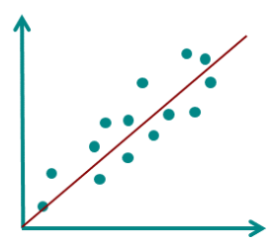
1) Linear regression

Slide 8
Linear regression = the "hello world" of ML

Slide 9
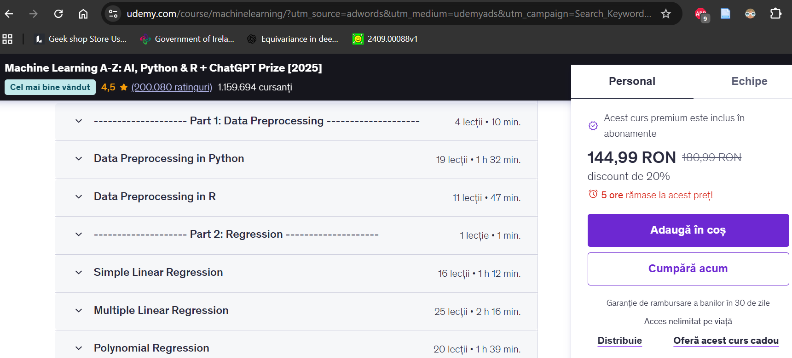
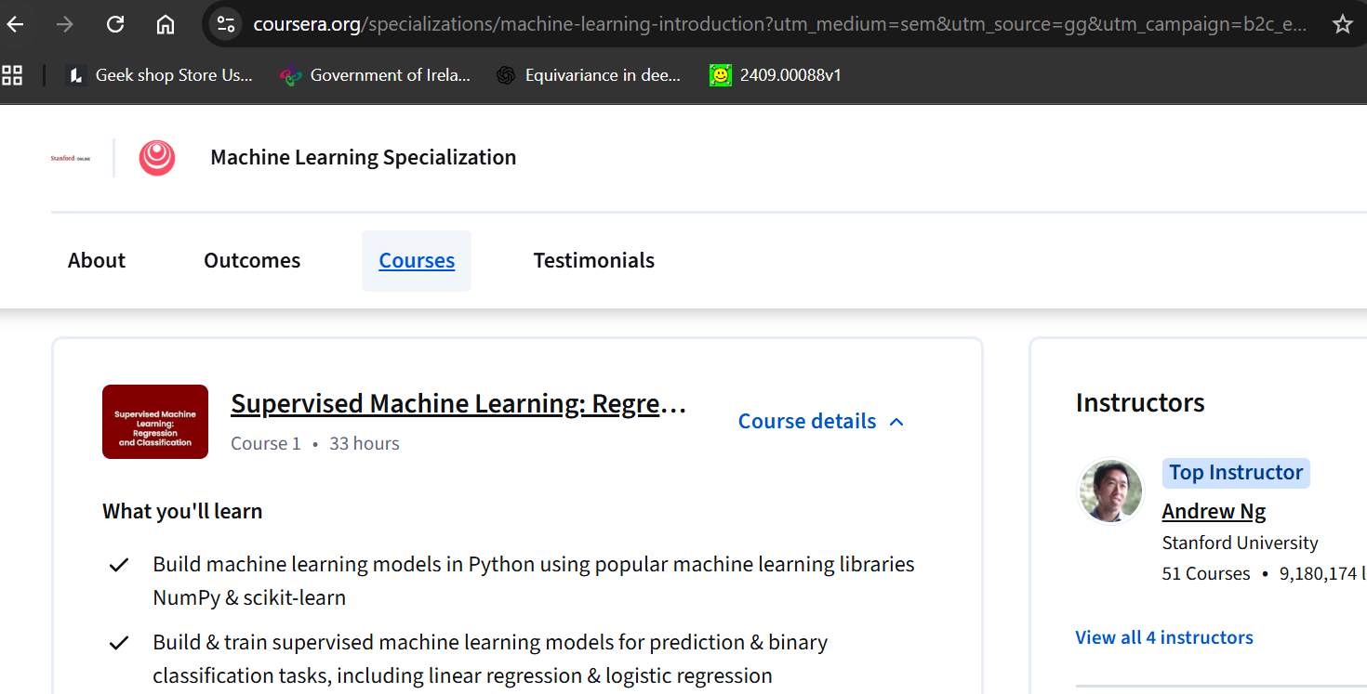
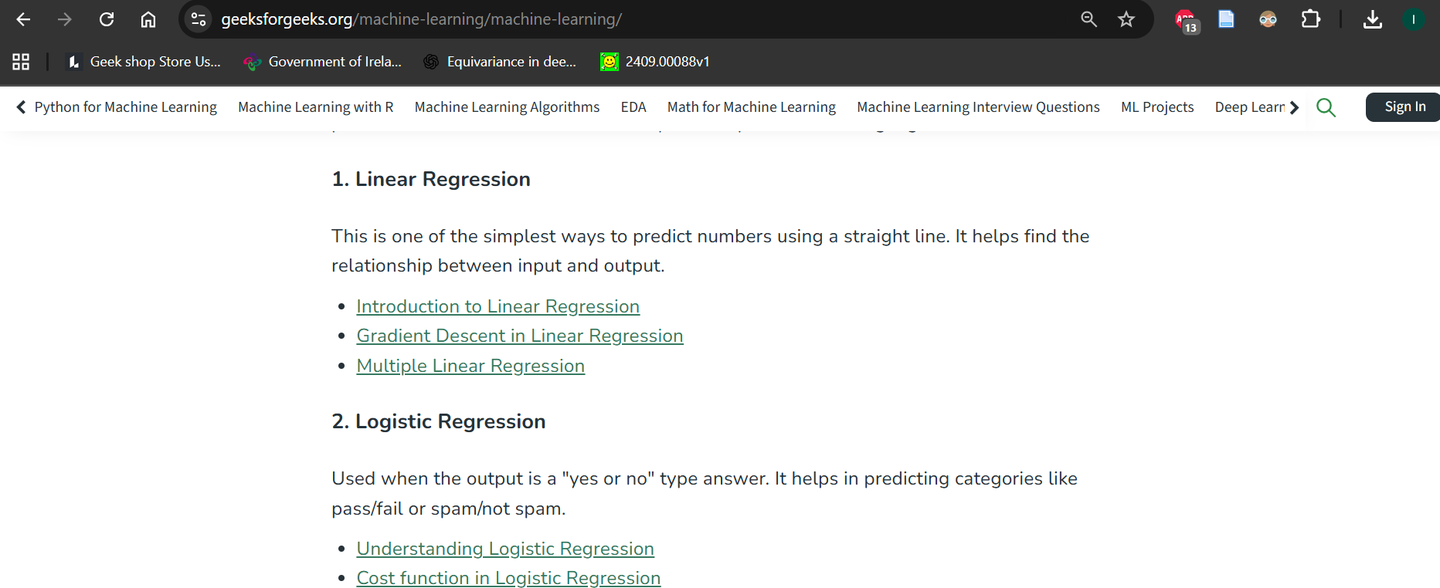

Slide 10

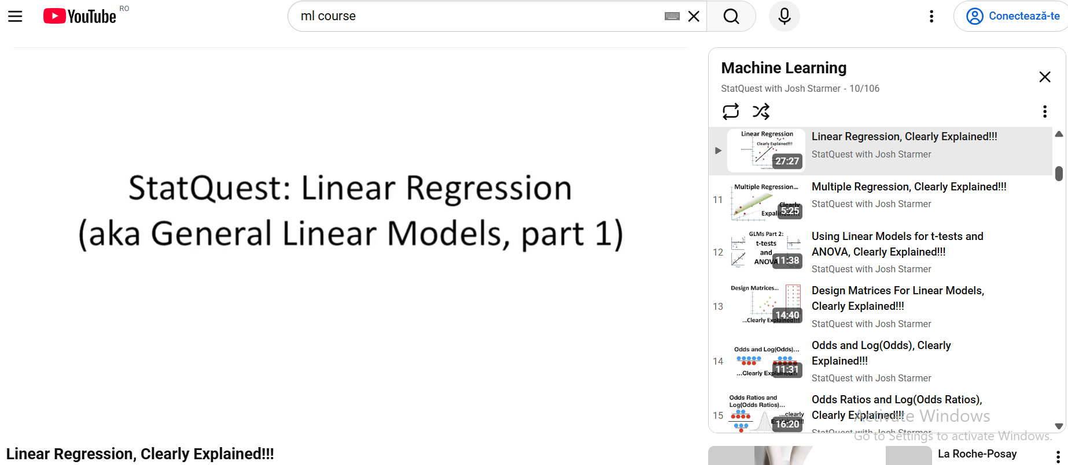


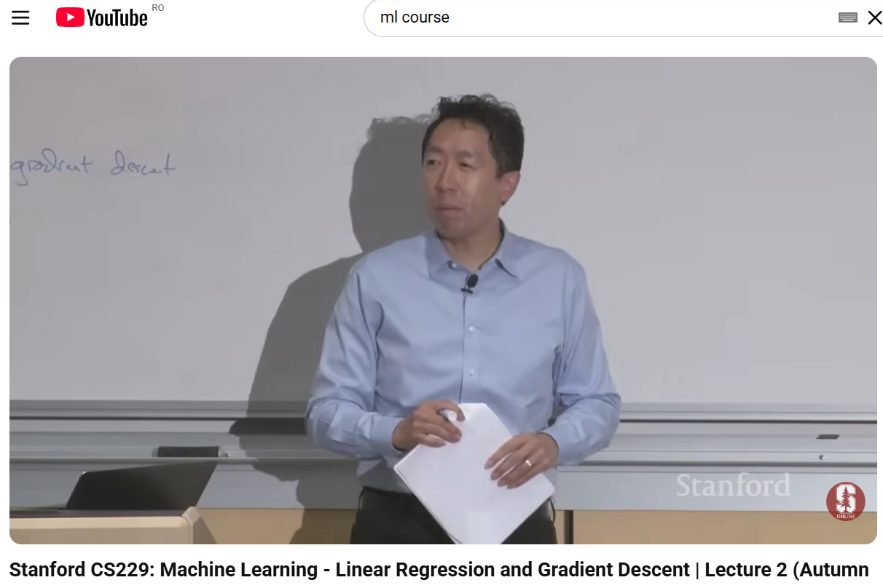

Slide 11

Linear regression everywhere!

Slide 12

Life is better with an example…

Slide 13
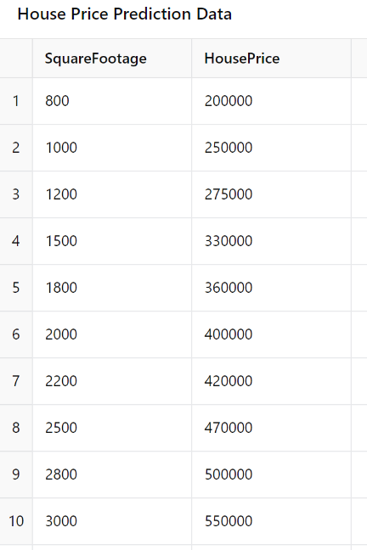
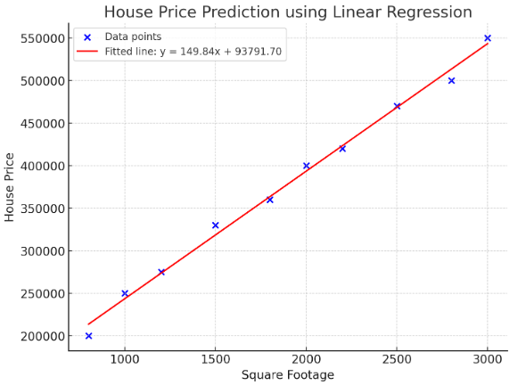

(2D)

Slide 14
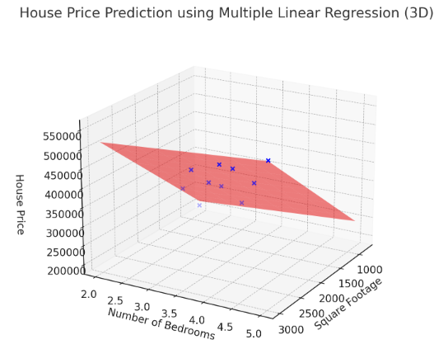

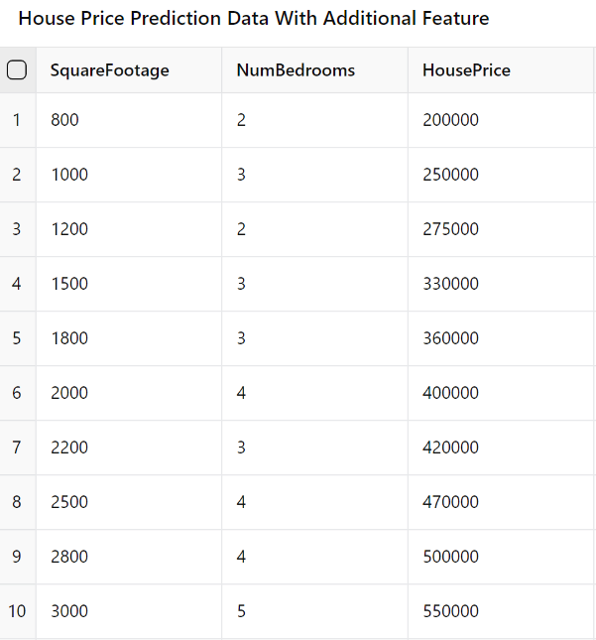

Slide 15
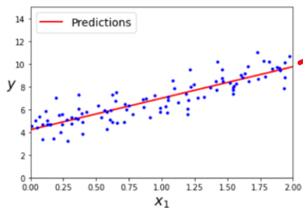
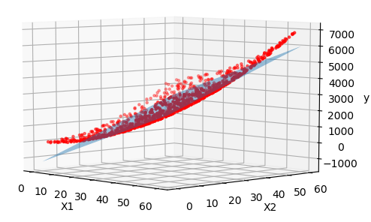


UDL Interactive Figures
see here 2.2 Least squares loss
d=2
d=3
equation of a line
equation of a plane

Slide 16
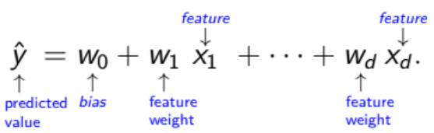


The linear regression model is:

Slide 17


Slide 18
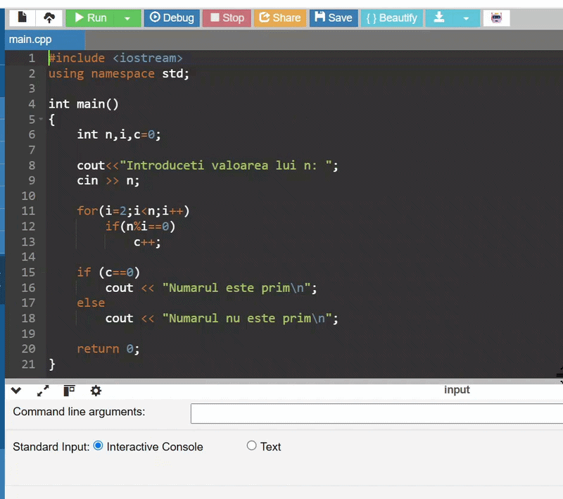
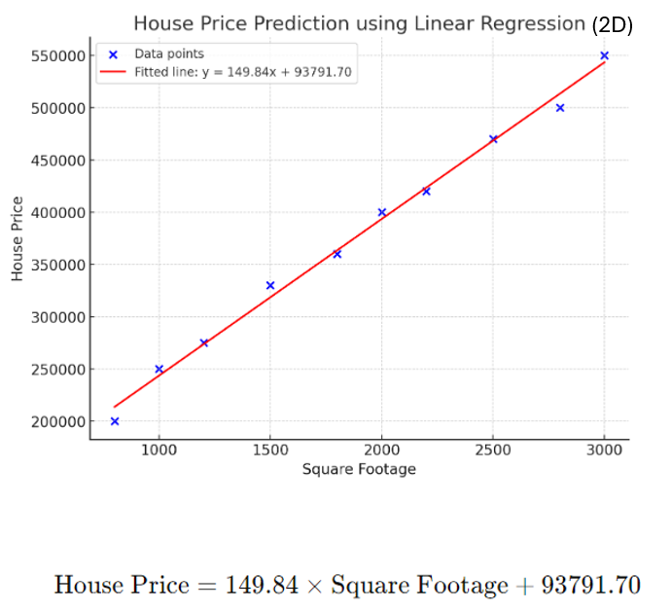
Teaching purposes …

Slide 19
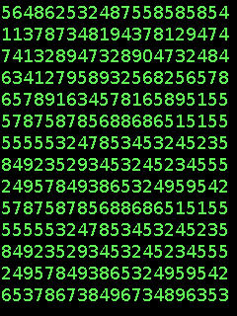
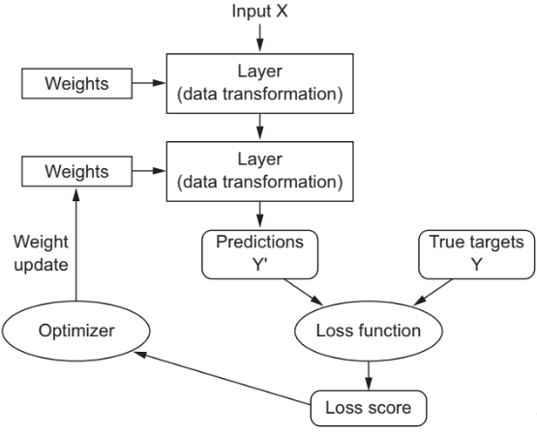
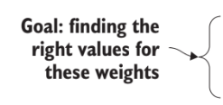

weights = matrices of numbers
ML/DL
model
math
e.g.
|Y - Y'|
(Y - Y')²
…

Slide 20
Let’s take it step by step…

Slide 21

weights = matrices of numbers
ML/DL
model
ML/DL
model
math
e.g.
|Y - Y'|
(Y - Y')²
…

Slide 22

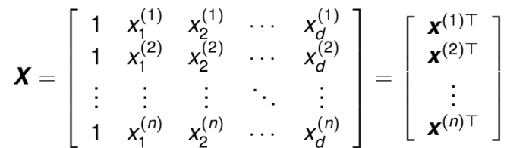
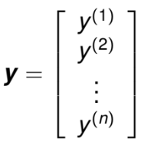
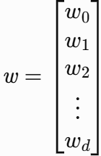
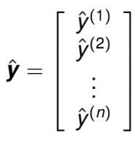

one input-output pair
inputs
targets
weights
predictions

Slide 23
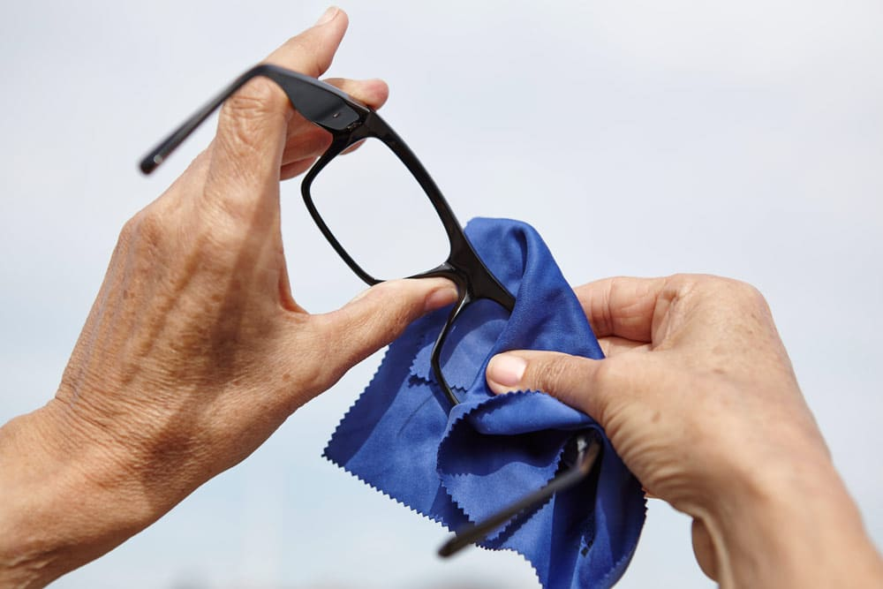

Slide 24
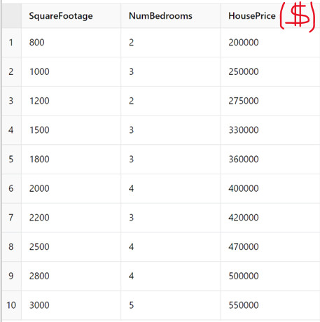
one input-output pair
inputs
targets

Slide 25

But why ….

Slide 26
The linear regression model is:
weights

Slide 27





Slide 28

The linear regression model is:
We want them to be the same!
linear regression model
predictions
targets

Slide 29
one input-output pair
inputs
targets
weights
predictions

Slide 30
weights = matrices of numbers
ML/DL
model
ML/DL
model
math
e.g.
|Y - Y'|
(Y - Y')²
…

Slide 31

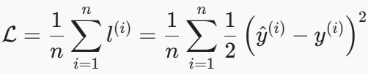
- squared error
- mean squared error

Slide 32


But why ….
and not or
?

Slide 33

A probabilistic interpretation of linear regression
(the ugly part from the course with probabilities ☺ )

Slide 34

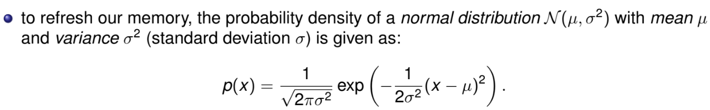
Measurement errors: Imperfections in the instruments or processes used to collect data.
External factors: Influences from environmental variables that aren’t modeled.
etc.
Example:
Imagine you're collecting data on house prices and you expect a linear relationship between the size of a house and its price. However, in reality, other factors (like the neighborhood, condition of the house, economic conditions) introduce noise into the data, so the actual price of a house deviates from the expected price based on its size.

Slide 35
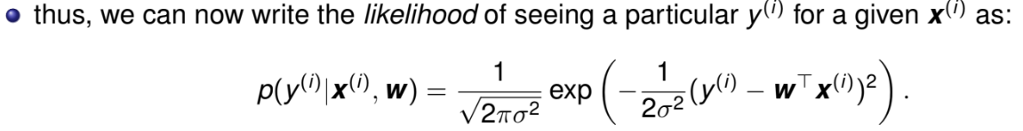

residual error follows a normal distribution with mean 0 and variance
the likelihood of appearing the residual error
The smaller the residual , the higher the likelihood of observing that data point
The higher the residual , the smaller the likelihood of observing that data point

Slide 36
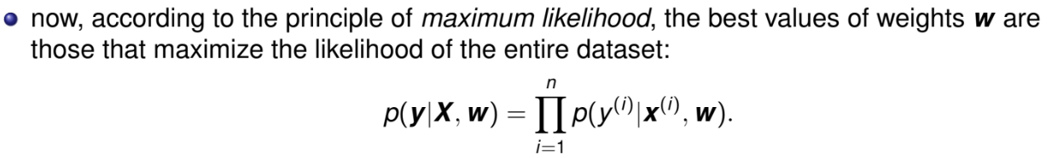
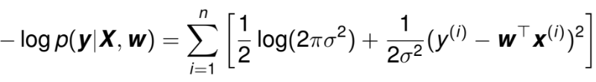
we want to maximize this!
mathematical proof on the next slide
maximizing the product of many exponentials might be difficult, so we instead minimize the following:
we want to minimize this!
negative log-likelihood

Slide 37

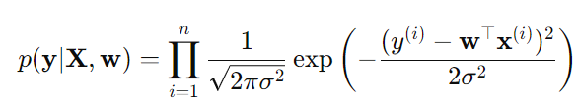
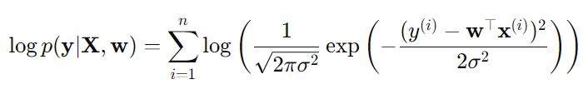
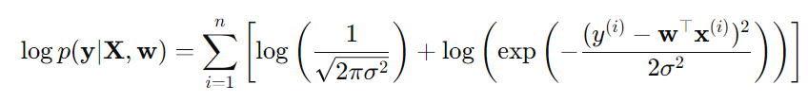

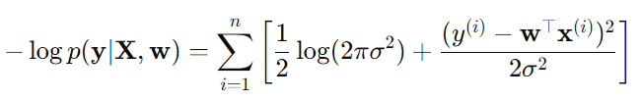
log
(
(
We used log(ab) = log(a) + log(b), thus the product became sum
(
(
We used the same formula as above ☺
, q.e.d.

Slide 38
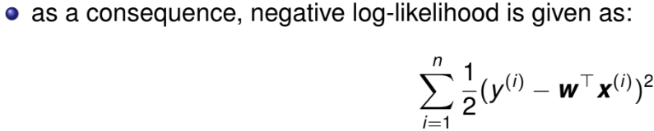
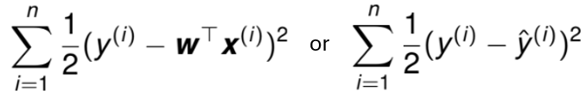
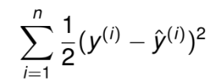

fixed, so we ignore it
fixed, so we ignore it
we want to minimize this!
or
(
(
we want to minimize this!
We will see why we keep this ½ factor

Slide 39
TL;DR: What Did We Learn?
Our data always has noise (errors, missing factors, randomness).
We assume this noise follows a normal distribution (see Central Limit Theorem).
We want to find weights that make model’s predictions fit the data as well as possible.
This is done by Maximum Likelihood Estimation (MLE).
In practice → minimize the squared differences between predictions and targets.

Slide 40
weights = matrices of numbers
ML/DL
model
ML/DL
model
math
e.g.
|Y - Y'|
(Y - Y')²
…

Slide 41


Slide 42



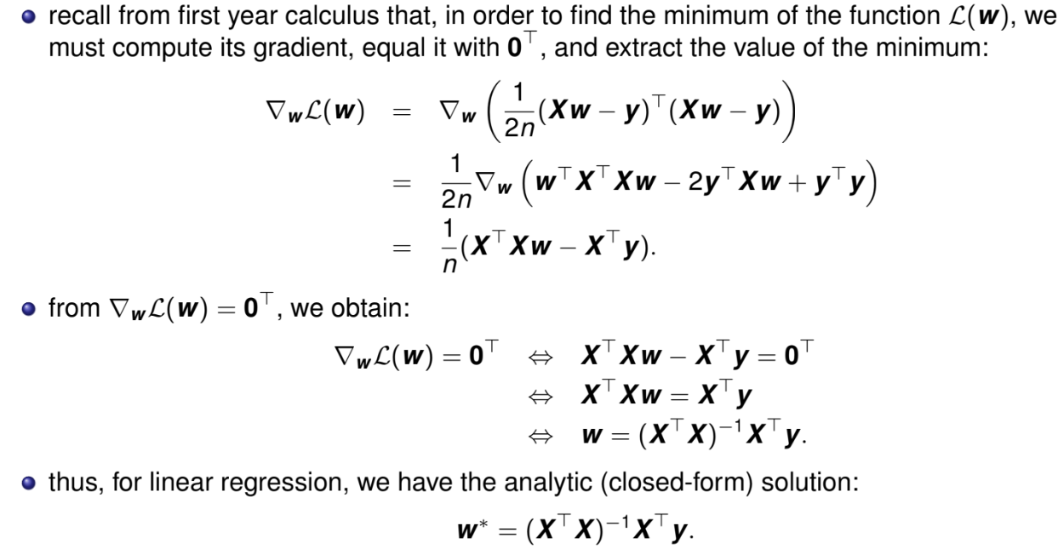


the mean squared error can be written as:
now we want to find the parameters w that minimizes it:
.
,
.
.

Slide 43
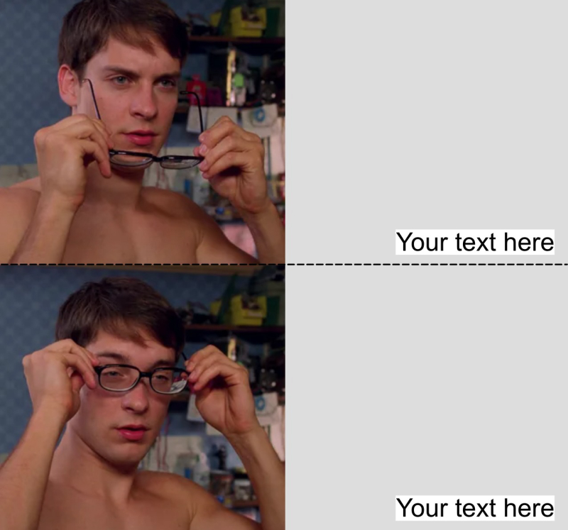
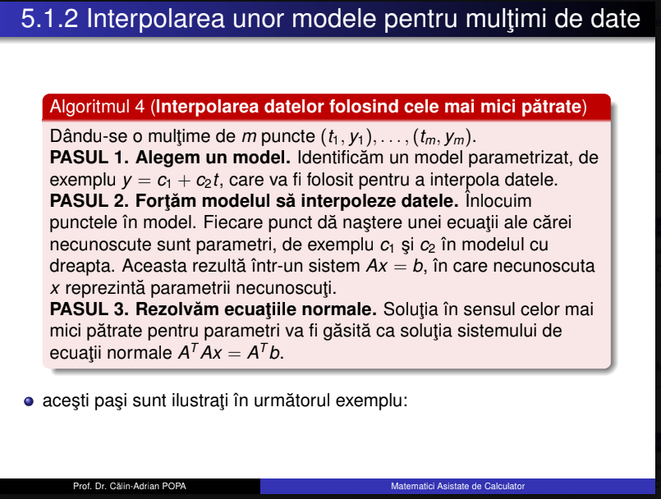


Slide 44
Code part

Slide 45
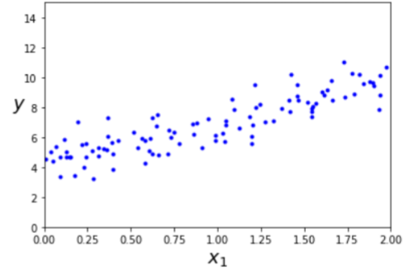

.

Slide 46
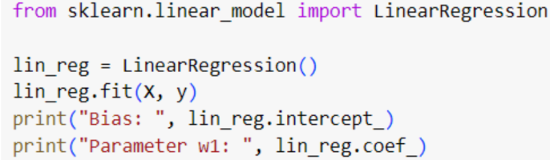
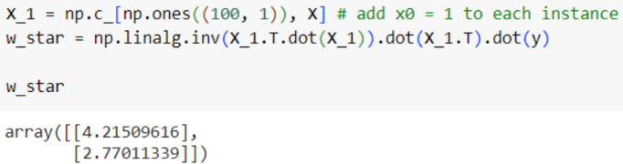

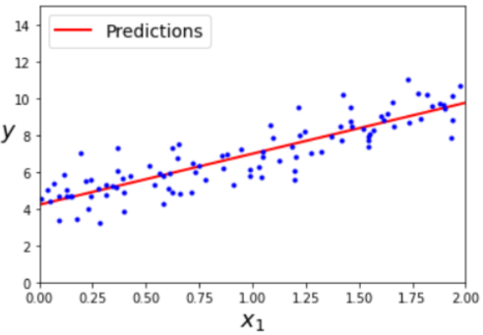
compute w*:
Method 1
Compute manually
Method 2
Use scikit-learn
The equation of the red line is:
4.215 + 2.770*x

Slide 47
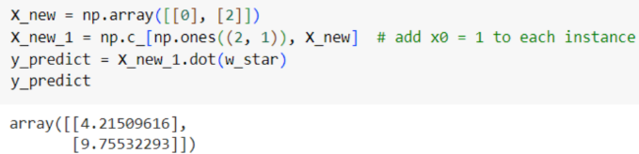


Generate predictions using w*:
Method 1
Generate manually
Method 2
Use scikit-learn
TL;DR:
if the input is 0, the prediction of linear regression model is 4.21…
if the input is 2, the prediction of linear regression model is 9.75…

Slide 48
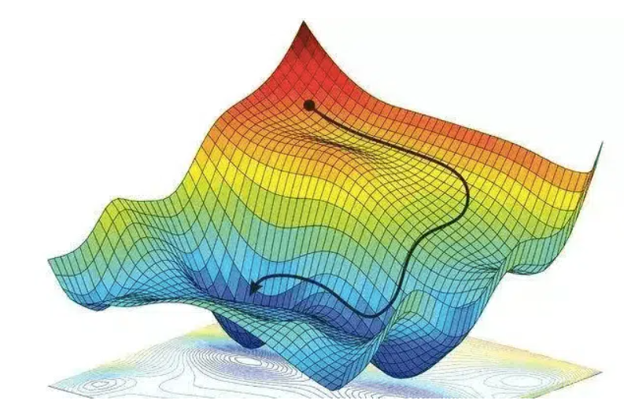
2) Gradient descent

Slide 49
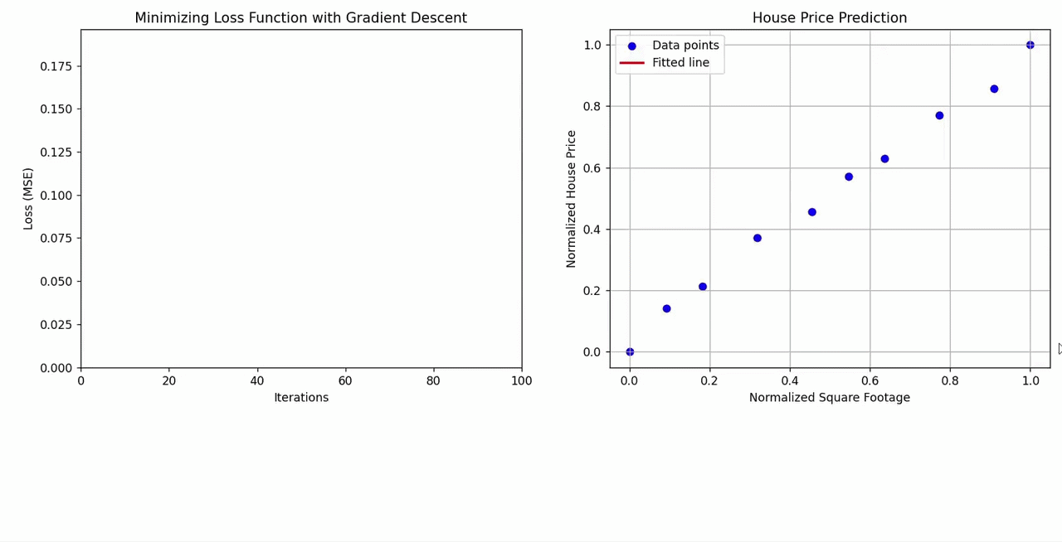
see here 2.4 Loss function:
UDL Interactive Figures

Slide 50
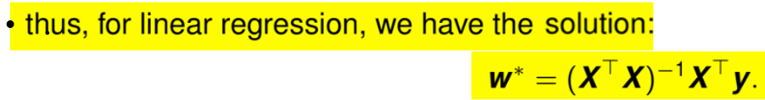








~
if d is large (e.g., 100, 000)

Slide 51

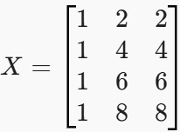

NOTE:
if d > n:
when X^{T}X is not invertible
we need single value decomposition (SVD) to compute (X^{T}X)⁻¹X^{T}
if one or more columns in X are identical:
~
if d is large (e.g., 100, 000)

Slide 52


Slide 53
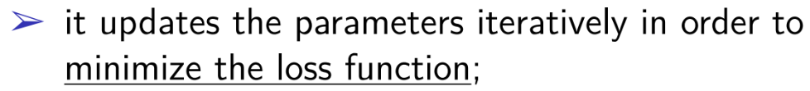

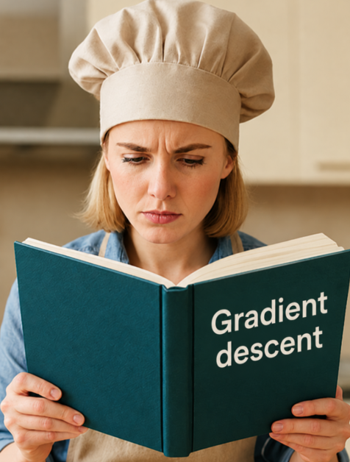

Solution: gradient descent !
initialize the model weights randomly;
iteratively update them:

Slide 54
Life is better with an example…

Slide 55



ML/DL
model
initially random
numbers
bad
“potato”
“dog”
12.8 - high

Slide 56

ML/DL
model
slightly better
numbers
meh
“rabbit”
“dog”
0.9 - medium

Slide 57

ML/DL
model
very good
numbers
champion
“dog”
“dog”
0.05 - low

Slide 58


Slide 59
But why ….
?

Slide 60



https://www.youtube.com/watch?v=5H7M5Vd3-pk&list=PLpFsSf5Dm-pd5d3rjNtIXUHT-v7bdaEIe&index=12
What is the derivative of a function?
h
f′(x) < 0:
the tangent has negative slope
the function decreases
f′(x) > 0:
the tangent has positive slope
the function increases
the derivative of a function f(x) at a point a gives the slope of the tangent line to the graph of the function at that point.
f′(x) = 0:
the tangent is horizontal (has zero slope)
the function is neither increasing nor decreasing

Slide 61


A positive gradient means the function is increasing.
A negative gradient means the function is decreasing.
gradient = multidimensional derivative
If is positive means the function is increasing, so by subtraction means that we go in the opposite direction (of decreasing the function)
If is negative means the function is decreasing, so by subtraction means that we keep the direction of decreasing
> 0
< 0
= 0

Slide 62




minimum

Slide 63


Some notes…
If the learning rate is too high, we might jump across the valley and end up on the other side, possibly even higher up than we were before and this might make the algorithm diverge
If the learning rate is too small, the algorithm will have to go through many iterations to converge, which will take a long time

Slide 64


Some notes…
If the random initialization starts the algorithm on the left, then it will converge to a local minimum, which is not as good as the global minimum.
Not all functions look nice, regular bowls
There may be holes, ridges, plateaus, etc., making convergence to the minimum difficult
If the random initialization starts the algorithm on the right, then it will take a very long time to cross the plateau and if we stop too early, we will never reach the global minimum .

Slide 65



Some notes…
see here 6.4 Gabor loss function:
UDL Interactive Figures
Fortunately, the mean squared error loss function for linear regression is always a convex function (“ține apa”)
This implies that there are no local minima, just one global minimum
Mean squared error loss function
Other loss functions
vs
local minimum
global minimum
w₁
w₁
w₀
w₀

Slide 66

Some notes…
see here 6.4 Gabor loss function:
UDL Interactive Figures
Other loss functions
vs

Slide 67


https://udlbook.github.io/udlbook/

Slide 68
Code part

Slide 69





Method 1: Implement manually
Method 2: Use scikit-learn
Batch Gradient Descent: Uses all the examples for every step.
Stochastic Gradient Descent: Uses one random example for every step.
Mini-Batch Gradient Descent: Uses a small random group of examples for every step.

Slide 70



Stochastic Gradient Descent
100 dog images
one random image

Slide 71
Batch Gradient Descent
100 dog images
all 100 images
“potato”
“dog”
“pig”
“dog”
100
…
…
100
“boat”
“dog”
16.6
13.4
average
one score
…
100
11.9

Slide 72

Mini-Batch Gradient Descent
100 dog images
a random batch of images (e.g. 16)
“potato”
“dog”
“pig”
“dog”
16
…
…
16
“boat”
“dog”
16.6
13.4
average
one score
…
16
11.9

Slide 73

Some notes…
When to use each:
• Batch Gradient Descent: Looks at all the training data before taking one step. Each step is accurate and smooth, but slow, and the whole dataset has to fit in memory. Best for small datasets.
• Stochastic Gradient Descent: Looks at one example at a time and takes a step right away. Very fast and cheap, but each step is noisy, so the path zig-zags toward the answer. Best for huge datasets.
• Mini-Batch Gradient Descent: Looks at a small group of examples (e.g., 32 or 64) per step. A middle ground: faster than Batch, less noisy than SGD, and it runs efficiently on GPUs. This is what's used in practice most of the time.

Slide 74

3) Polynomial regression

Slide 75





Slide 76


Slide 77



1. Start with Linear Regression:
2. Expand Inputs:
$x⟶φ\left(x\right)=\left[1,x1,x2,…,xd,{x1}^{2},{x2}^{2},…,x1x2,…\right]$
3. Run Linear Regression on :
Key takeaway: Change the features, keep the algorithm.

Slide 78



Bias/Variance trade-off
Suppose we have the following non-linear data:
We want to apply polynomial regression for it:

Slide 79

low variance,
high bias
high variance,
low bias
best model !
Increasing a model’s complexity high variance and low bias overfitting
Decreasing a model’s complexity low variance and high bias underfitting

Slide 80

Overfitting/Underfitting
Underfitting: model is too simple poor performance on both training and test datasets.
Overfitting: model is too complex fits the training data "too well," even capturing noise and random fluctuations. performs poorly on unseen data because it lacks generalization

Slide 81







Slide 82



Overfitting/Underfitting
Overfitting (the nerd/egghead 🤓)
Studies every single detail of the textbook, even the footnotes and rare exceptions.
On the exam, if the exact same question from the book appears, he nails it.
But if the question is slightly different, he gets confused because he memorized instead of understanding.
Underfitting (the too-chill guy 😎)
Barely studies, just skims the summary.
On the exam, he can only answer the most obvious questions.
He misses the deeper or trickier ones because he didn’t learn enough detail.
Best fit (the actually smart guy 🧠)
Understands the material well, without obsessing over useless details.
On the exam, he can handle both the standard and the slightly different questions.

Slide 83
TL; DR
Linear Regression
Polynomial Regression

Slide 84
Code part

Slide 85



We use fit_transform() method and PolynomialFeatures class to transform our training data, adding the square (second-degree polynomial) of each feature in the training set as a new feature
X[0], X[0]²

Slide 86


Now we can fit a LinearRegression model to this extended training data, thus obtaining polynomial regression:
Not bad:
    the model estimates
    the original function was

Slide 87

use the trained polynomial regression model to predict new values across the input range and plot the smooth fitted curve over the data:

Slide 88
4) Regularized linear models

Slide 89


But why ?
Ridge Regression
Lasso Regression
Elastic Net Regression
Linear Regression
better loss function
Linear regression loss
To combat overfitting

Slide 90
Life is better with an example…

Slide 91







Slide 92
Code part

Slide 93



Slide 94
Variant 1

Slide 95












10
ŷ = 1.00 + 0.36·x₁
0.01
ŷ = 0.99 + 0.37·x₁
0.5
ŷ = 1.50 + 0.00·x₁

Slide 96
Variant 2

Slide 97







Slide 98

5) Logistic regression

Slide 99
Logistic regression = Binary classification
(e albă ori e neagră)

Slide 100
Life is better with an example…

Slide 101
Student Name | Hours Studied | Result (Pass=1, Fail=0)
Alice | 0.5 | 0
Bob | 0.75 | 0
Charlie | 1 | 0
David | 1.25 | 0
Emma | 1.5 | 0
Frank | 1.75 | 0
George | 1.75 | 1
Hannah | 2 | 0
Ian | 2.25 | 1
Jane | 2.5 | 0
Kevin | 2.75 | 1
Liam | 3 | 0
Marie | 3.25 | 1
Nora | 3.5 | 0
Oliver | 4 | 1
Paul | 4.25 | 1
Rachel | 4.5 | 1
Sam | 4.75 | 1
Tom | 5 | 1
Victor | 5.5 | 1
Problem to Solve
Predict whether a student will pass or fail an exam.
Input: hours studied.
Output: binary result (Pass = 1, Fail = 0).

Slide 102






Compute a score with linear regression formula:
2. Turn the score into a probability with the sigmoid function:
3. Make a decision with a threshold:
- Fail
- Pass
a function that takes any number (from negative infinity to positive infinity) and converts it into a value strictly between 0 and 1:

Slide 103

Student Name | Hours Studied | Result (Pass=1, Fail=0)
Alice | 0.5 | 0
Bob | 0.75 | 0
Charlie | 1 | 0
David | 1.25 | 0
Emma | 1.5 | 0
Frank | 1.75 | 0
George | 1.75 | 1
Hannah | 2 | 0
Ian | 2.25 | 1
Jane | 2.5 | 0
Kevin | 2.75 | 1
Liam | 3 | 0
Marie | 3.25 | 1
Nora | 3.5 | 0
Oliver | 4 | 1
Paul | 4.25 | 1
Rachel | 4.5 | 1
Sam | 4.75 | 1
Tom | 5 | 1
Victor | 5.5 | 1

Slide 104
Code part

Slide 105




versicolor
setosa
virginica
Transform
based on:
sepal width
sepal length
petal width
petal length
Linear regression
ML/DL
model
not virginica
virginica
not virginica
virginica

Slide 106






it contains the sepal and petal length and width of 150 iris flowers of 3 different species: setosa, versicolor and virginica.
3 classes
4 features

Slide 107





Inspecting the data…
first flower from the dataset
second flower from the dataset
0: setosa
1: versicolor
2: virginica

Slide 108

Before making the split, the train_test_split() method shuffles the dataset using a pseudorandom number generator.
If we just took the last 25% of the data as a test set, all the data points would have the label 2, as the data points are sorted by the label (see the output for iris['target'] shown earlier).
Using a test set containing only one of the 3 classes would not tell us much about how well our model generalizes, so we shuffle our data to make sure the test data contains data from all classes.
Sanity check:
NOTE:
If you want to split the dataset different than 75% and 25% you need to modify the default parameters of the train_test_split() function

Slide 109



Let’s now use logistic regression to build a binary classifier to detect the iris virginica type.
Basically, we will have 2 classes: iris virginica and not iris virginica. We transform the targets correspondingly:
Now let’s train a LogisticRegression model:
In order to evaluate the accuracy of the logistic regression model on the test set, we use the score() method:
our model correctly classified 97.3% of the examples in the test set !
We can use the predict() method to apply the trained model on the first example in the test set:
The model predicted that the first example in the test set is an iris virginica!

Slide 110

We can also inspect the probabilities the model assigned to the negative and positive classes, respectively, using the predict_proba() method:
The model is 91.5% sure that the example is an iris virginica!

Slide 111

6) Softmax regression

Slide 112
Softmax regression = Multiclass classification
(e albă ori e neagră ori e roșie ori …)

Slide 113
Life is better with an example…

Slide 114
Student Name | Hours Studied | Result (Olympiad=2,Pass=1, Fail=0)
Alice | 0.5 | 0
Bob | 0.75 | 0
Charlie | 1 | 1
David | 1.25 | 0
Emma | 1.5 | 0
Frank | 1.75 | 2
George | 1.75 | 1
Hannah | 2 | 0
Ian | 2.25 | 1
Jane | 2.5 | 0
Kevin | 2.75 | 2
Liam | 3 | 0
Marie | 3.25 | 1
Nora | 3.5 | 0
Oliver | 4 | 1
Paul | 4.25 | 1
Rachel | 4.5 | 1
Sam | 4.75 | 2
Tom | 5 | 1
Victor | 5.5 | 2
Problem to Solve
Predict whether a student will pass or fail an exam.
Input: hours studied.
Output: multiclass result (Olympiad =2, Pass = 1, Fail = 0).

Slide 115




Compute a score for each class with linear regression formula:
2. Turn the scores into probabilities with the softmax function:
3. Pick the class with the highest probability:
NOTE:

Slide 116




m
m
Used for logistic regression
Used for softmax regression

Slide 117
Code part

Slide 118
based on:
sepal width
sepal length
petal width
petal length
Softmax regression
ML/DL
model
versicolor
setosa
virginica

Slide 119


Switch from logistic to softmax regression
Let’s use softmax regression to classify the iris flowers into the 3 classes:
our model correctly classified 97.3% of the examples in the test set!
Again, we can use the predict() method to apply the trained model on the first example in the test set:
The classes are: 0 – setosa
1 – versicolor
2 - virginica.
Thus, the model thinks that the first example in the test set is an iris virginica !

Slide 120

We can again inspect the probabilities the model assigned to the three classes, using the predict_proba() method:
This model is 99.7% certain that the first example in the test set is an iris virginica.
The first 2 probabilities correspond to the setosa and versicolor classes, respectively.
We can verify that the 3 probabilities add up to 1 model outputs a probability distribution over the 3 classes.

Slide 121

Linear Regression: Learn a straight-line relationship between inputs and outputs.
Gradient Descent: Iteratively adjust weights to minimize the error.
Polynomial Regression: Extend linear regression to capture curved relationships.

Slide 122



Regularized Models (Ridge/Lasso/Elastic Net): Prevent overfitting by changing loss function.
Logistic Regression: Turn regression into binary classification using the sigmoid function.
Softmax Regression: Generalize logistic regression to handle multiple classes.
“e albă ori e neagră”
“e albă ori e neagră ori e roșie ori…”

Slide 123

Logistic Regression and Softmax Rergession
- Why Are They Called “Regression” if They Do Classification? -
1. The model underneath is a regression model
Logistic Regression and Softmax Regression compute a linear regression on the input:
This part is pure regression: a weighted sum of the features, just like in linear regression.
2. The classification comes only after applying a non-linearity
For binary classification, logistic regression applies the sigmoid:
For multiclass classification, softmax regression applies softmax:
The model still performs a regression first; the nonlinearity turns the output into probabilities.
TL; DR
They are called “regression” because the core model is linear regression.
They perform “classification” because their output is passed through sigmoid or softmax.
So the name describes the mathematical form, not the task.

Slide 124



Slide 125


Slide 126
Exercises

Slide 127


Slide 128


Slide 129



Slide 130
Big picture first, details last

Slide 131


Slide 132


Slide 133




Slide 134



Solutions

Slide 135





why this shape for w? ☺
why this formula? ☺

Slide 136






NOTE: it’s always good to print and plot some examples to see how the data looks like and to create an idea about it. We can also use in this example DESCR attribute to read a description of the data.
digits dataset contains images of hand-written digits: 10 classes where each class refers to a digit
the model predicts that the second example in the test set is the digit 8

Slide 137




Slide 138
Thank you !

